Slide 1
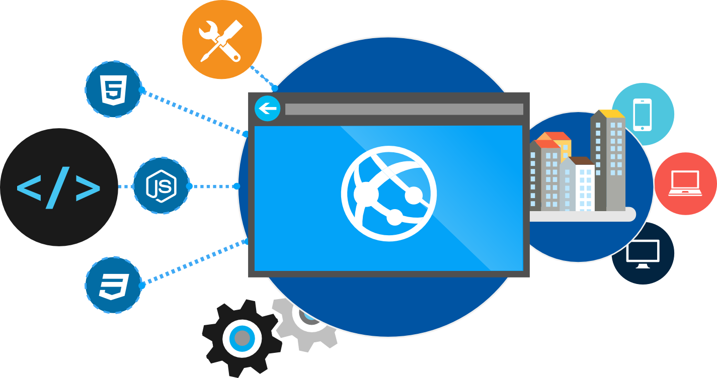
Intro to Docker
James Sturtevant
@aspenwilder
//jamessturtevant
Notes:
Going to take you back to a time before shipping standards were in place.

Slide 2
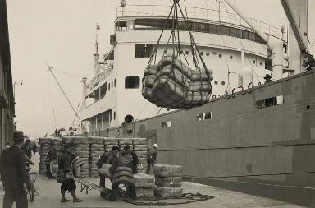
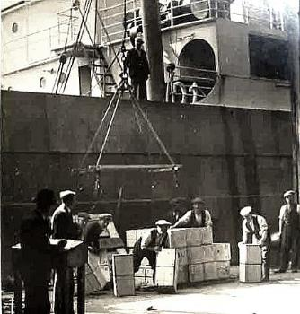
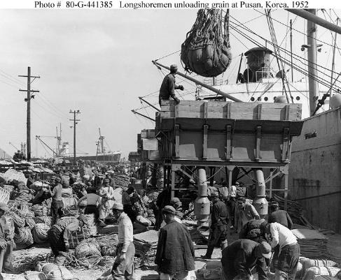
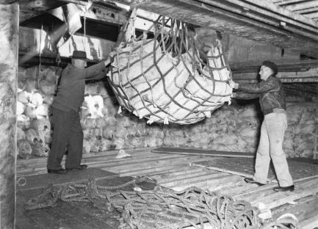
Before Container Standards
Notes:
Going to take you back to a time before shipping standards were in place to frame the concept which was borrowed like so many others.
Everything was loaded individual. Took lots of man power. Items would get mixed and matched. Items would be all over the ship.

Slide 3
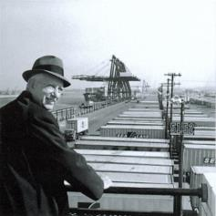
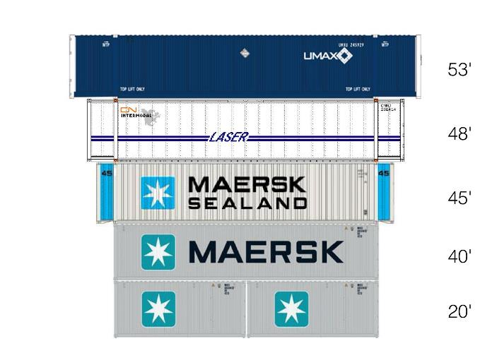
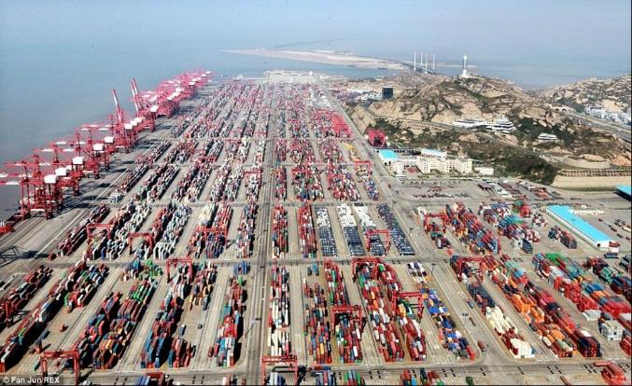
Shipping Containers Invented
In 1956, most cargo was loaded and unloaded by hand. Hand-loading a ship cost $5.86 a ton.
Malcom McLean born in 1913 developed the modern intermodal shipping container, which revolutionized transport and international trade.
McLean knew "A ship earns money only when she's at sea," and based his business on that efficiency.
Using containers, it cost only 16 cents a ton, a 39-fold savings. Containerization also greatly reduced the time to load and unload ships, improving reliability.
https://en.wikipedia.org/wiki/Malcom_McLean
Notes:
It was such a tough and demanding process that the were able to cut the savings by 39X. Imrpoved reliability by putting everything in the same conatieers. Faster load process.
It was so revolutionary that today we can’t event image a situation with containers.
Container techonology in software is likely to feel the same way in a few years. We won’t be able to dream a time with out it.
As far as the cost saving goes I would say that you would likely see something similar if we were as good about tracking cost and effort in software. Im not sure that many of us are thought we are moving forward as in industry.

Slide 4
What is a container?
Traditional virtual machines = hardware virtualization
Application
VM
VM
VM
OS
Hardware

Slide 5
What is a container?
OS
Hardware
Traditional virtual machines = hardware virtualization
Application
VM
VM
VM
OS
Hardware

Slide 6
What is a container?
Containers = Operating system virtualization
OS
Applications
Kernel
Hardware
Traditional virtual machines = hardware virtualization
Application
VM
VM
VM
OS
Hardware

Slide 7
What is a container?
Containers = Operating system virtualization
OS
CONTAINER
CONTAINER
CONTAINER
Applications
Kernel
Hardware
Traditional virtual machines = hardware virtualization
Application
VM
VM
VM
OS
Hardware

Slide 8
App A
App A’
App B
Containers are isolated, but share OS and, where appropriate, bins/libraries
Bins/Libs
Bins/Libs
Bins/Libs
Guest OS
Guest OS
Guest OS
App A
App A’
App B
App B’
App B
App B’
App B
App B’
Bins/Libs
Bins/Libs
Hypervisor
Docker Engine
Host OS
Host OS
Server
Server
Notes:
We have had a similar technology through the use of VM’s in the past but it was very heavy weight. It is like have a boat carry boats of boats full of shipping containers. Big beefy machines to hold other machines
With container technologies, to solution is much more light weight and is more like having the containers directly on the boat. You get a higher density of applications/verisons/services on one machine. This becomes really important for two reasons. First one is cost saving on you part. Less hardware is a good thing. Second we you start to talk at the scale like amazon or azure it means they can have higher density and that adds up quick and passing off saving to you.
Another thing to note here is the share bins libraries.
TRANSITION – OK you sold that containers are a good thing. How do I get started with Docker?

Slide 9
Docker, Docker, Docker
Notes:
Did I Mention about Docker
Containers have been around for many years
Docker Inc. did not invent them
created open source software to build and manage containers
Docker makes containers easy
Docker provides a container packaging format
creating a Docker hub ( a github of containers, more on it later)

Slide 10
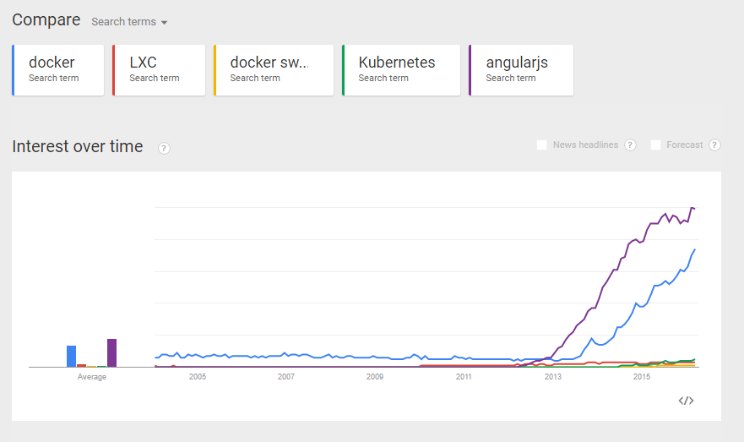

Slide 11
Container runtimes other than Docker
lxc
first linux containers implementation it was not really user friendly (did not have concept of images, hence docker happened)
used by Docker for quite a while, then got swapped out.
systemd-nspawn
may be used to run a command or OS in a light-weight namespace container
rkt
by CoreOS, Docker competitor, application container engine developed for modern production cloud-native environments different image spec
runC
includes all of the plumbing code used by Docker to interact with system features related to containers
Notes:
Namespaces and cnames. If you look through the source of linux you will not see the word container as we use it for this techonology
Cnames limit resources
Namespaces change world view of the container by making them seem like they are the only one.
Comon already…. Show me docker

Slide 12
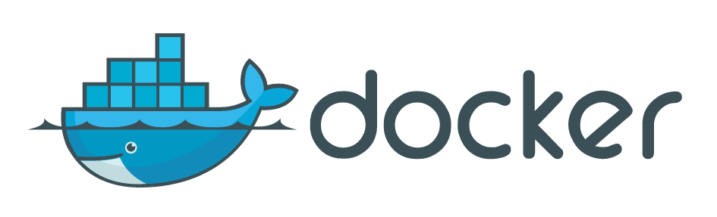
Notes:
Hopefully docker’s logo makes sense to you now.

Slide 13
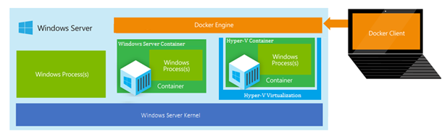
What about Windows?
Windows Server Containers
Hyper-V Containers – More Isolation, less density
Both just communicate using the Docker client/engine

Slide 14
What is a Windows container?
Containers = Operating system virtualization
OS
CONTAINER
CONTAINER
CONTAINER
Applications
Kernel
Hardware
Traditional virtual machines = hardware virtualization
Application
VM
VM
VM
OS
Hardware

Slide 15
What is a Windows container?
Containers = Operating system virtualization
Windows Server Containers
Maximum speed and density
OS
CONTAINER
CONTAINER
CONTAINER
CONTAINER
CONTAINER
CONTAINER
Applications
Kernel
Kernel
Hardware
Traditional virtual machines = hardware virtualization
Application
VM
VM
VM
OS
Hardware

Slide 16
Just like Linux containers…. With a bonus.
Containers = Operating system virtualization
Windows Server Containers
Maximum speed and density
OS
CONTAINER
CONTAINER
CONTAINER
CONTAINER
CONTAINER
CONTAINER
Applications
Kernel
Kernel
Hardware
Hyper-V Containers
Isolation plus performance
Traditional virtual machines = hardware virtualization
CONTAINER
CONTAINER
CONTAINER
Application
VM
VM
VM
OS
Kernel
Kernel
Kernel
Hyper-V
Hardware

Slide 17
Linux Containers on Hyper-V
Linux
Windows
Linux
Kernel
Kernel
Kernel
OS
Hyper-V
”The docker/end-user experience the goal/plan is that it’s just a docker pull/docker run – regardless of whether the image is Linux or Windows based”

Slide 18
Why containers?

Slide 19
How do containers make it easier?
Consistency
Efficiency
Rapid
Deployment
Fast Iterations
Service Separation
High Availability
Reproducibility
On Any Cloud
Scalability
Test at Scale
Immutability
Reduced Costs
Notes:
Reporducibility
Immutabliy
On an cloud
Scalablitliy
Reduced costs - desinity

Slide 20
Docker Specifics

Slide 21
Terminology
Docker Host VM machine running the containers
Docker Client CLI between user and Docker Host
Docker Hub Sharing and managing images

Slide 22
Terminology
Docker Images
Docker Containers
- ready-only (Immutable) templates that help define Docker containers
- Actual running instance of a container (writable)
Read-Write Layer
Container
4
Read Layer
3
Read Layer
Image
2
Read Layer
1
Notes:
There is a lot more to this but for now that is all you need to know.
Think: objects are instantiation of class. Containers are instances of images.
This is important later on during build.
Brought to you by Union Mounts. (https://en.wikipedia.org/wiki/Union_mount)

Slide 23
Docker Run
Downloads image & creates & starts container
docker run hello-world
docker run -it ubuntu /bin/bash
Notes:
Interactive and telly type attached to it.

Slide 24
Docker Images
View images
Notes:
Interactive and telly type attached to it.

Slide 25
Docker ps
Show running containers
Notes:
Interactive and telly type attached to it.

Slide 26
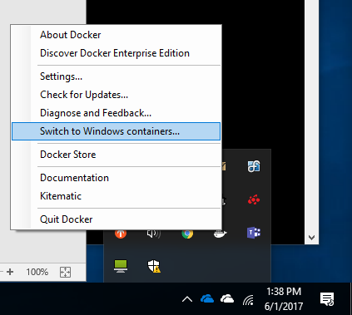
Switching to Windows

Slide 27
Docker Run Windows
docker run -it microsoft/nanoserver cmd

Slide 28
Getting IP Address
docker inspect
-f "{{ .NetworkSettings.Networks.nat.IPAddress }}"
containerid

Slide 29
Docker Run Hyper-V
docker run -it
--isolation=hyperv microsoft/nanoserver cmd

Slide 30
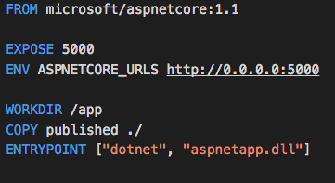
A Dockerfile is your “recipe”
A text file where you tell Docker what you want in your Docker image
Takes a snapshot every command, uses cache for performance
Notes:
How do you make these images and give commands and get files on to the containers?
The first FROM line tells Docker that we will use the official ASP.NET image on Docker Hub as our base image.
The COPY line tells Docker that we will copy contents of this folder (.) to the /app directory of the container and the WORKDIR instruction will move to the /app directory.
The RUN instruction tells Docker to run the dnu restore command to install the dependencies of the application. We do this before running out application for the first time.
he EXPOSE instruction will inform Docker that this image has a service which will be listening at port 5004 (see project.json of the sample file for details).
Lastly, the ENTRYPOINT instruction is the command executed to start the container and keep it up and running
https://blogs.msdn.microsoft.com/webdev/2015/01/14/running-asp-net-5-applications-in-linux-containers-with-docker/

Slide 31
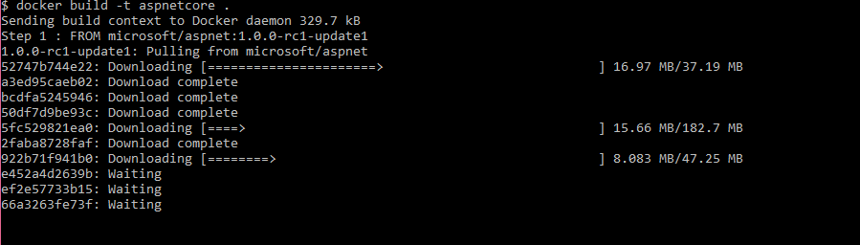
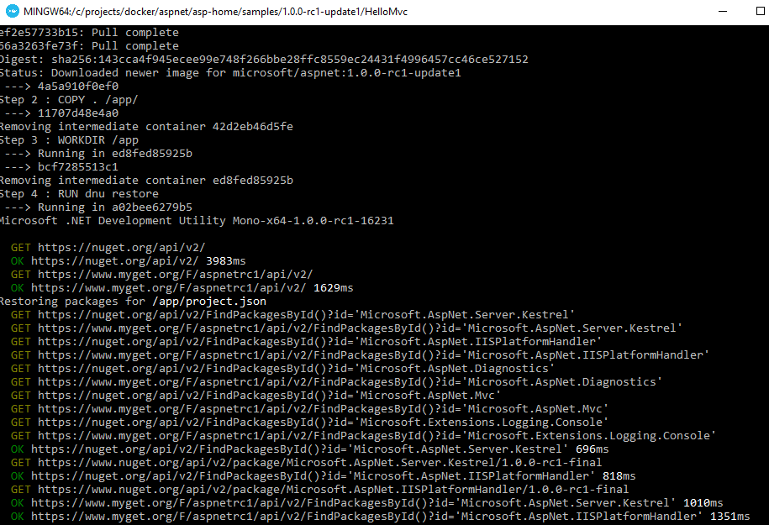
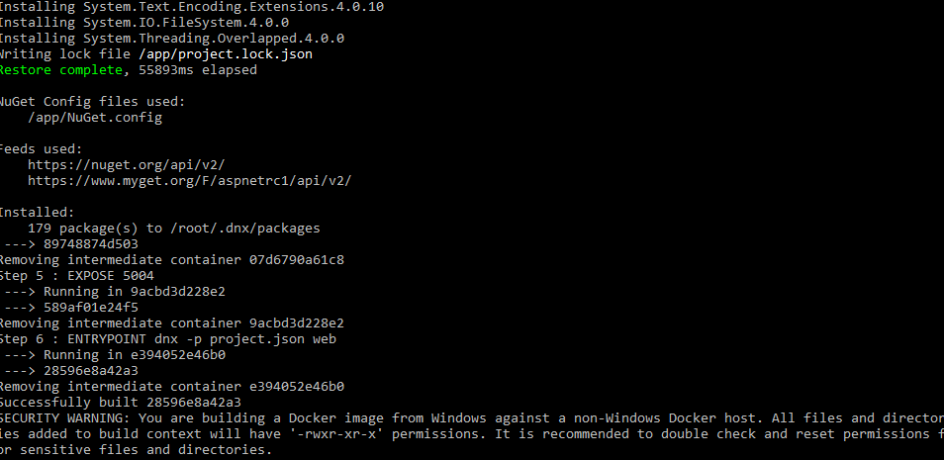
Docker Build
Creates the image
docker build –t aspnetcore .
Notes:
Everytime you change your app you re-run this.
docker build -t myapp .
-t give it a name.
Dot says to use files in the folder.

Slide 32
Image Registries
What is a registry?
Stores container images
Images are Pushed into a registry
Images are Pulled from a registry
Images are Searched for within a registry
Notes:
Ok great but what do I do with them now? How do I share?

Slide 33
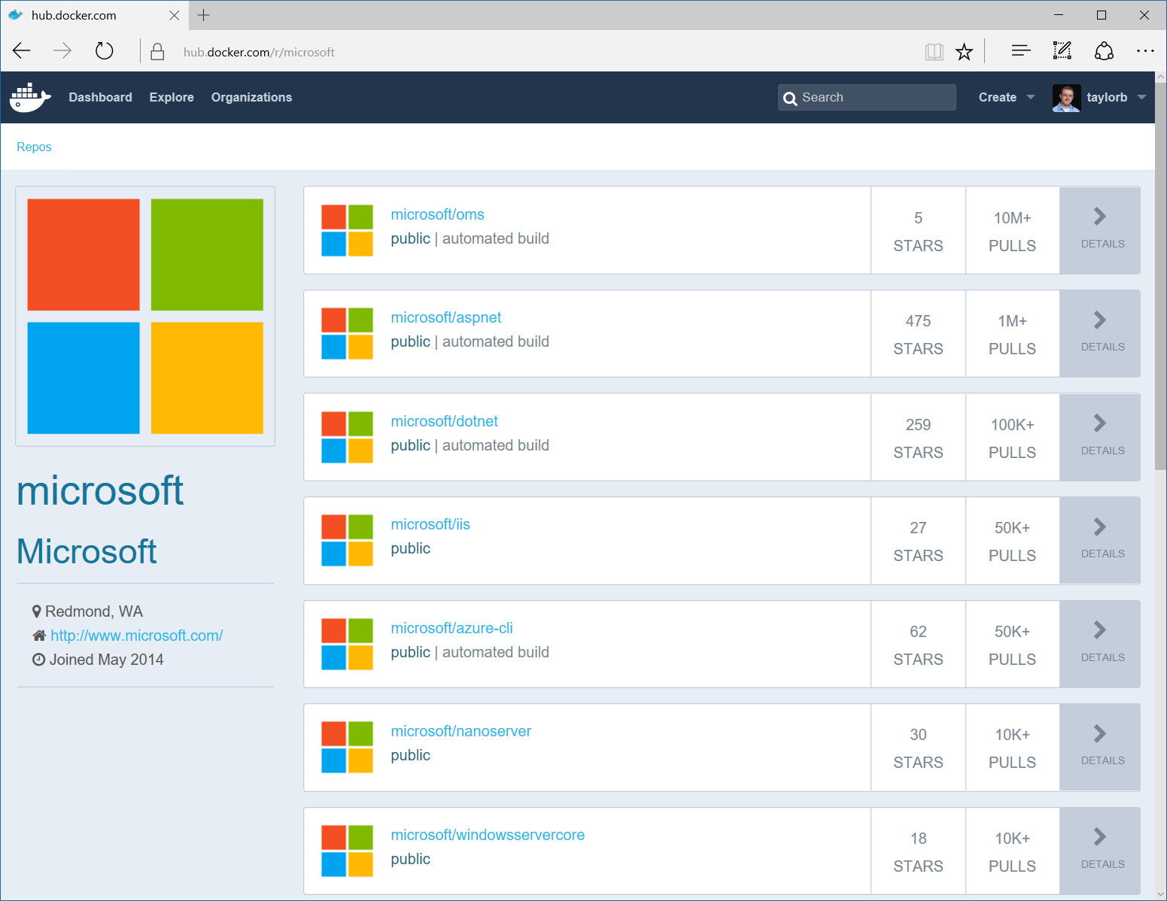
Image Registries
Docker Hub and Docker Store
Public, Official and Private image repositories
Docker Trusted Registry
Enterprise Grade Private Registries
Docker Registry
Open source foundation of Hub and DTR
Azure Container Registry
Currently in Preview
Store your container image in local, network-close storage on Azure
Notes:
Docker Hub and Docker Store
Public, Official and Private image repositories
Granular access controls with organization support
Automated image build support
Docker Trusted Registry
Enterprise Grade Private Registries
Runs on your infrastructure (on-prem or cloud)
Active Directory and Role Based Access Controls
Docker Registry
Open source foundation of Hub and DTR
Runs on your infrastructure (on-prem or cloud) as a container
https://docs.docker.com/registry and or https://github.com/docker/distribution
Azure Container Registry
Currently in Preview
Store your container image in local, network-close storage on Azure
Use Azure Active Directory to manage access
Manage Windows and Linux container images in a single registry

